Slide 1
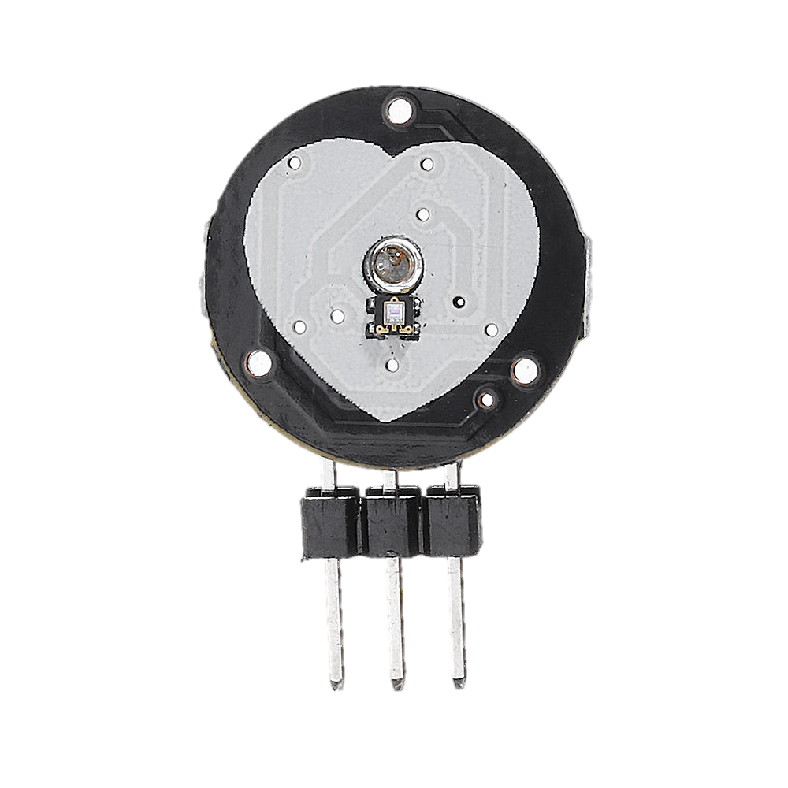

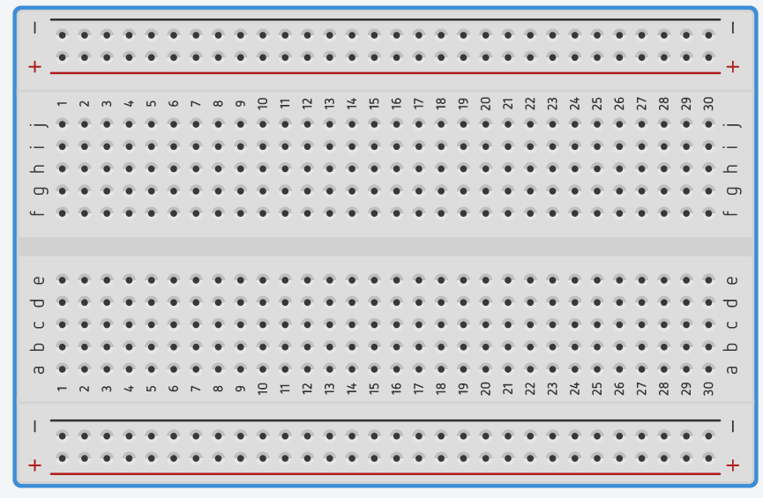
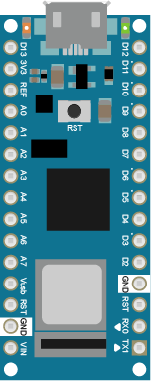
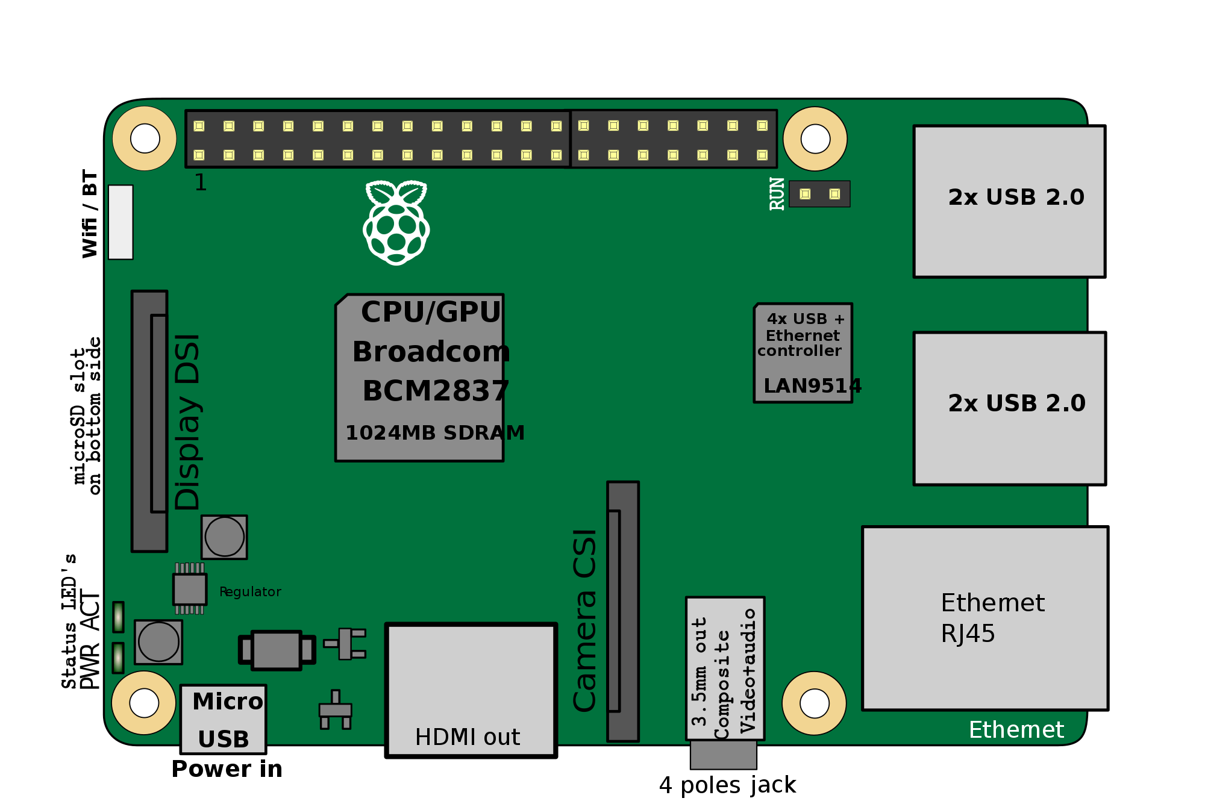

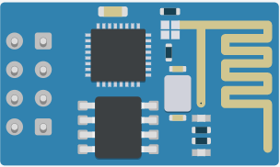
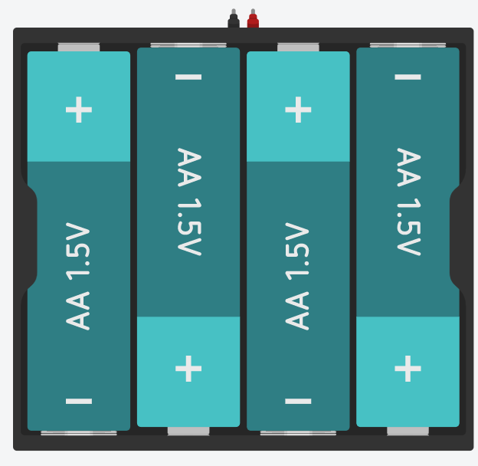
-
+
S
+
S
-
5V
TX
GND
EN
IO0
RST
IO2
3v3
RX
3.3V

Slide 2
-
+
S
+
S
-
5V
TX
GND
EN
IO0
RST
IO2
3v3
RX
3.3V

Slide 3
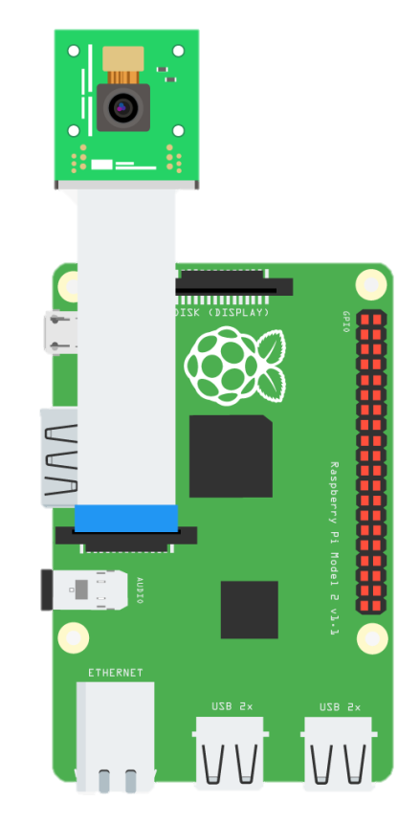

Heart Pulse Sensor
Temperature Sensor
Raspberry Pi Camera
-
+
S
+
S
-
5V
Arduino Nano
4.7 kΩ Resister
TX
GND
EN
IO0
RST
IO2
3v3
RX
ESP 8266
(Wi-Fi Module)
3.3V
Raspberry Pi
Power Supply 6V
Note: Arduino And Raspberry Pi communicates through Wi-Fi connection

